Slide 1
Comic project

Slide 2
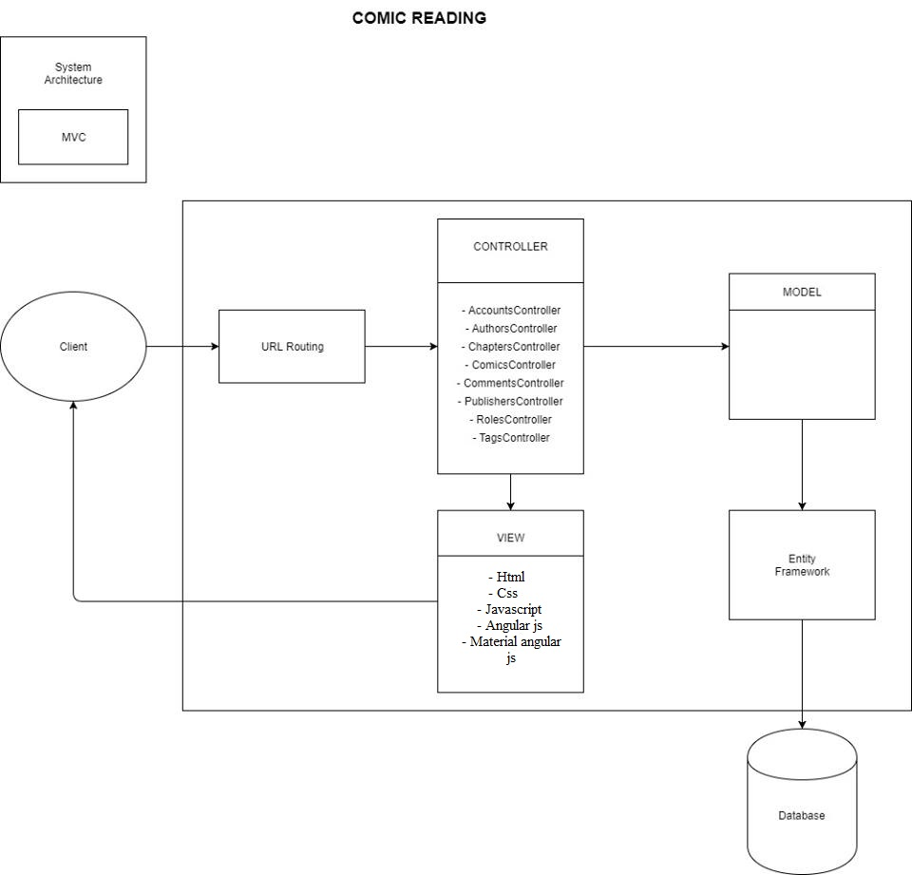
System Architecture Diagram

Slide 3
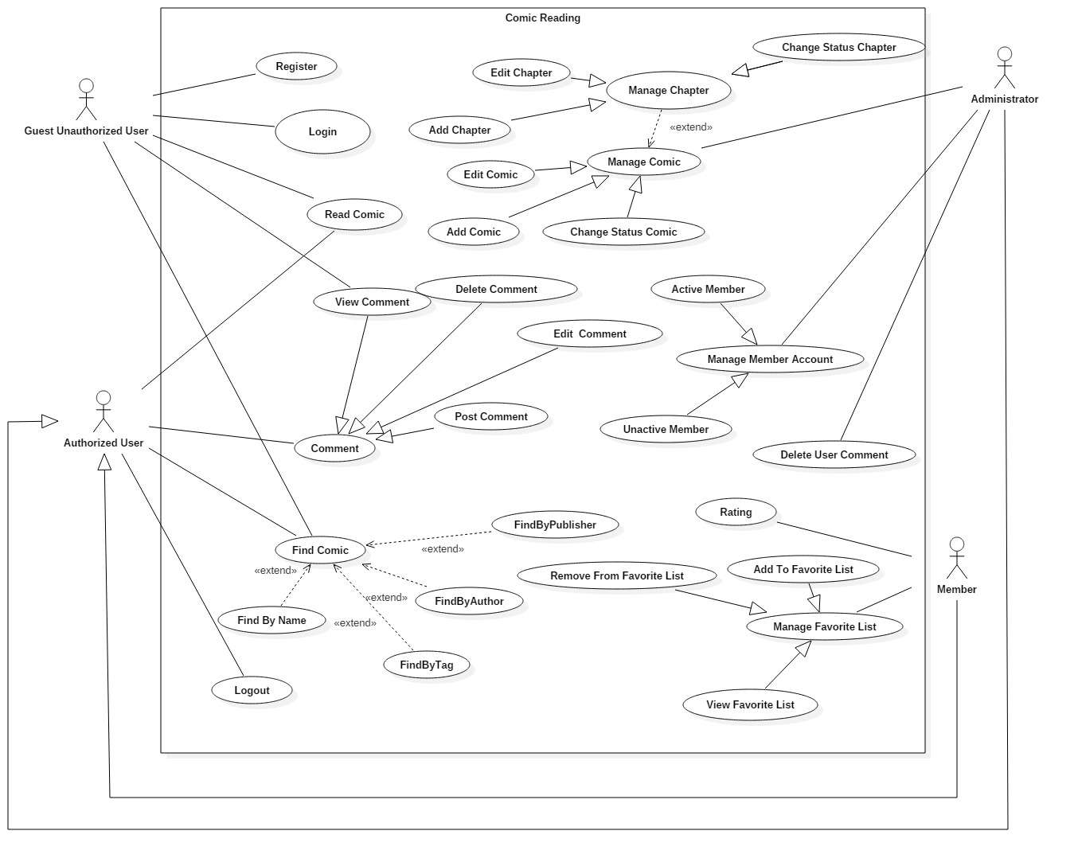
Usecase diagram

Slide 4
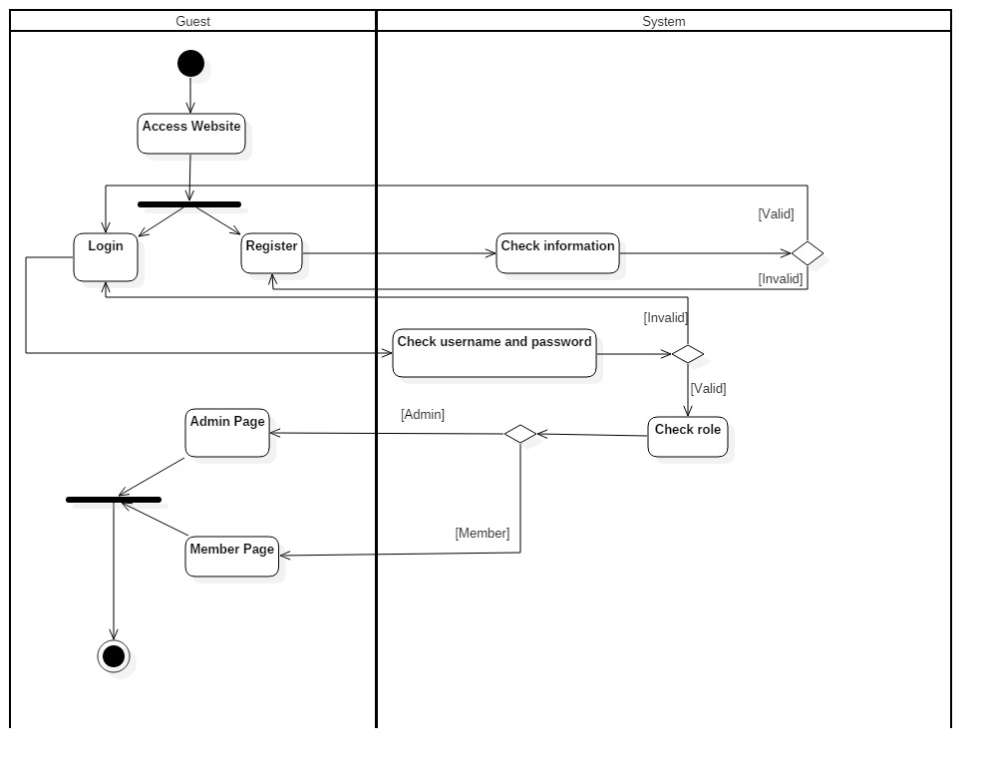
Activity diagram

Slide 5
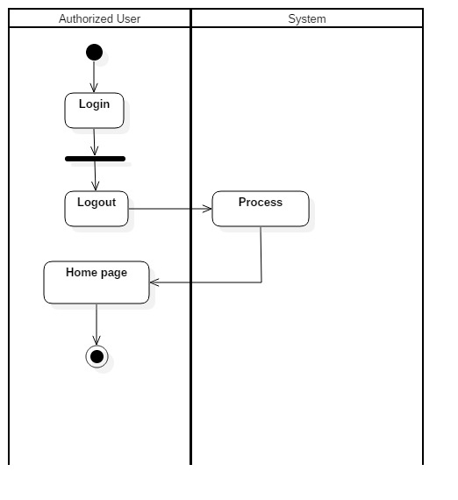
Activity diagram

Slide 6
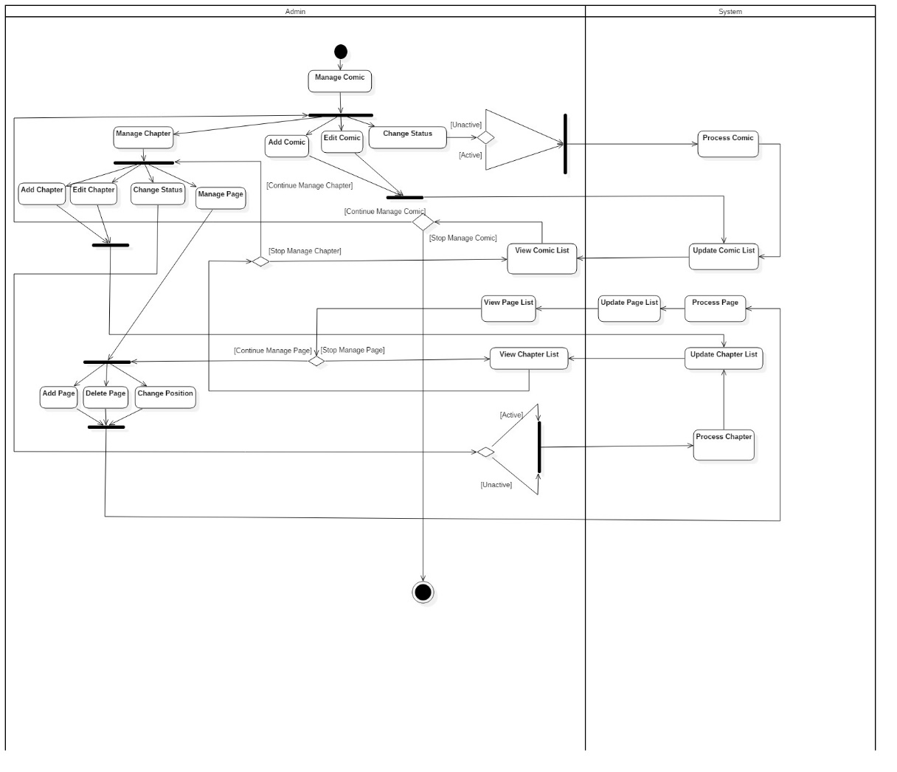
Activity diagram

Slide 7
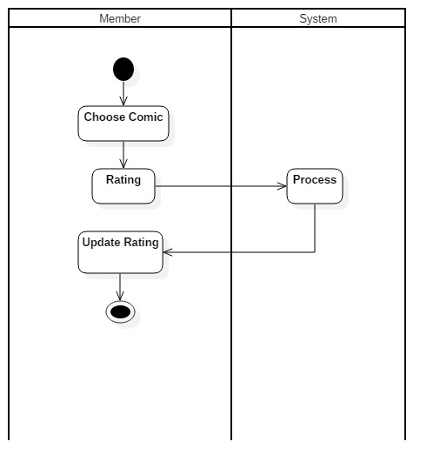
Activity diagram

Slide 8
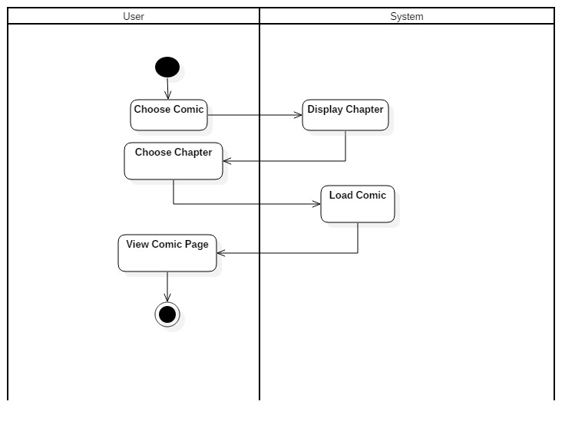
Activity diagram

Slide 9
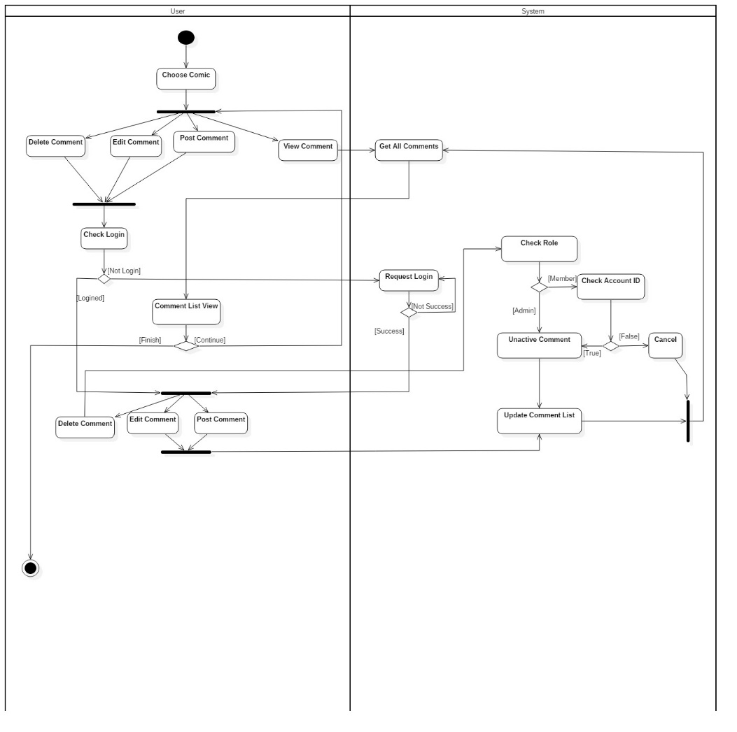
Activity diagram

Slide 10
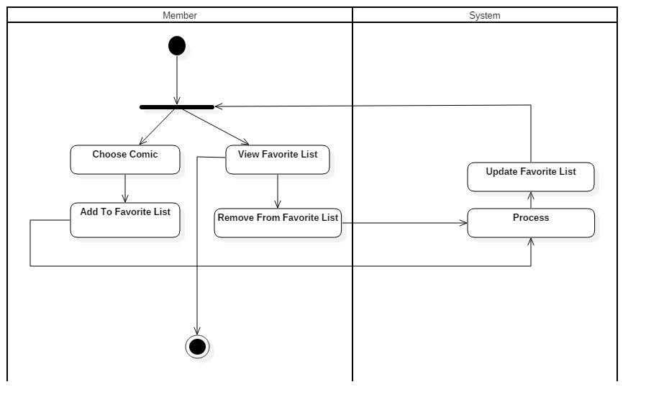
Activity diagram

Slide 11
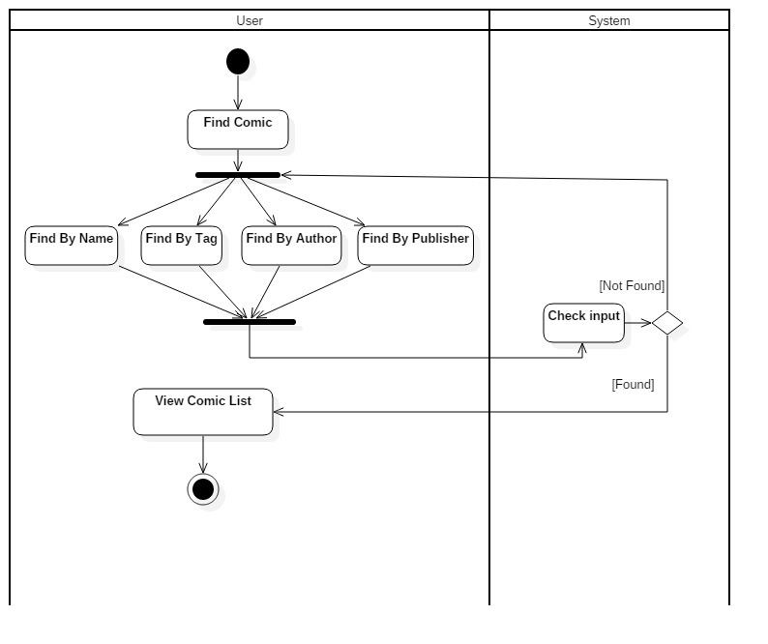
Activity diagram

Slide 12
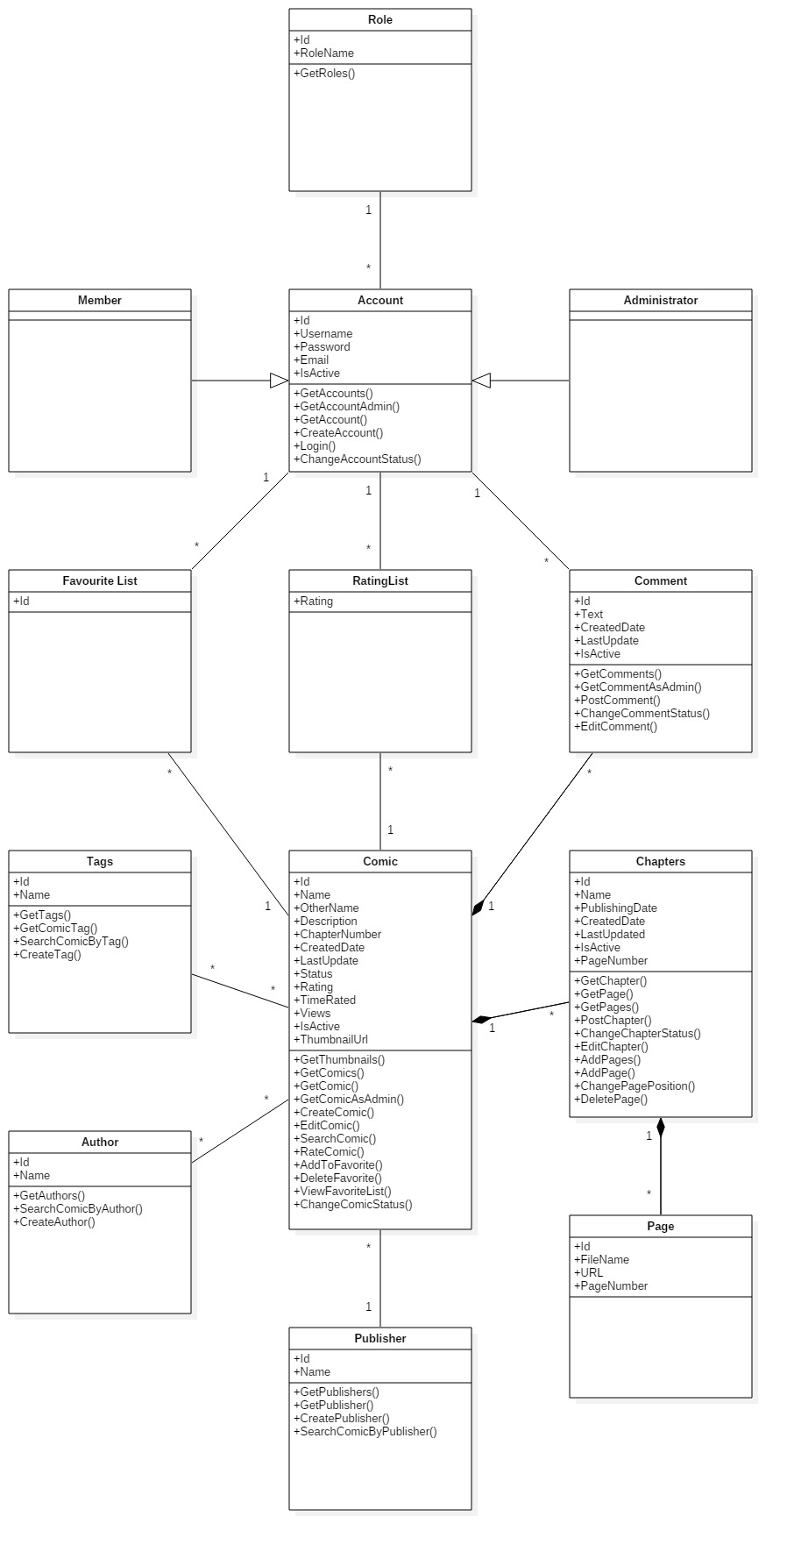
Class diagram

Slide 13
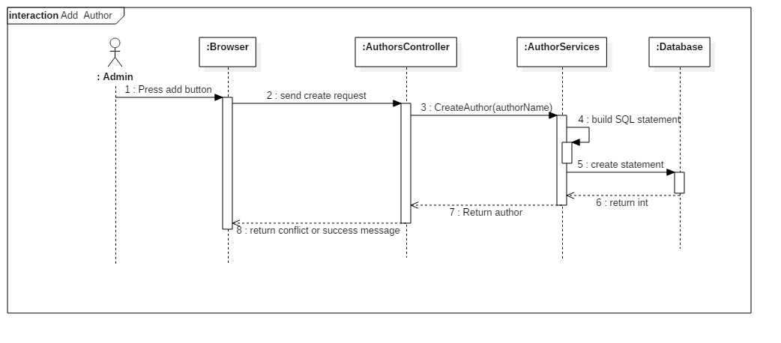
Sequence Diagram
Add Author

Slide 14

Sequence Diagram
Add publisher

Slide 15
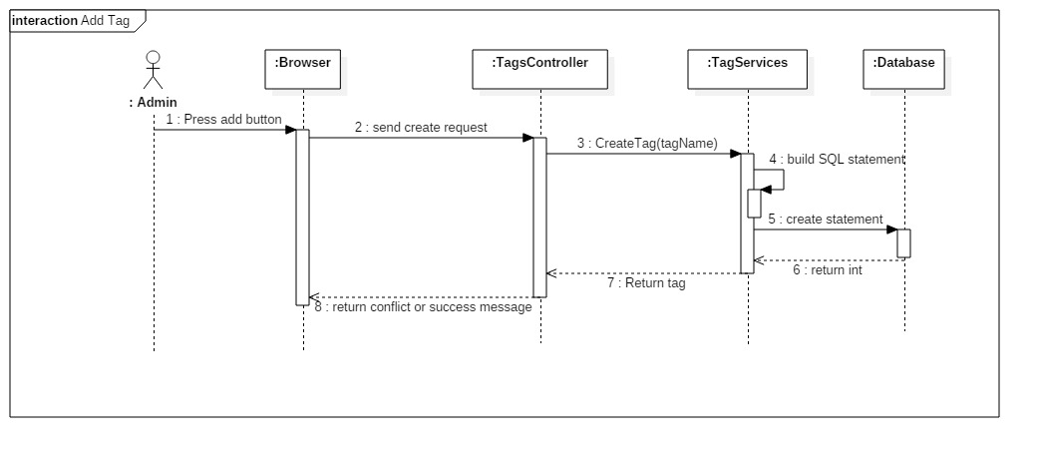
Sequence Diagram
Add Tag

Slide 16
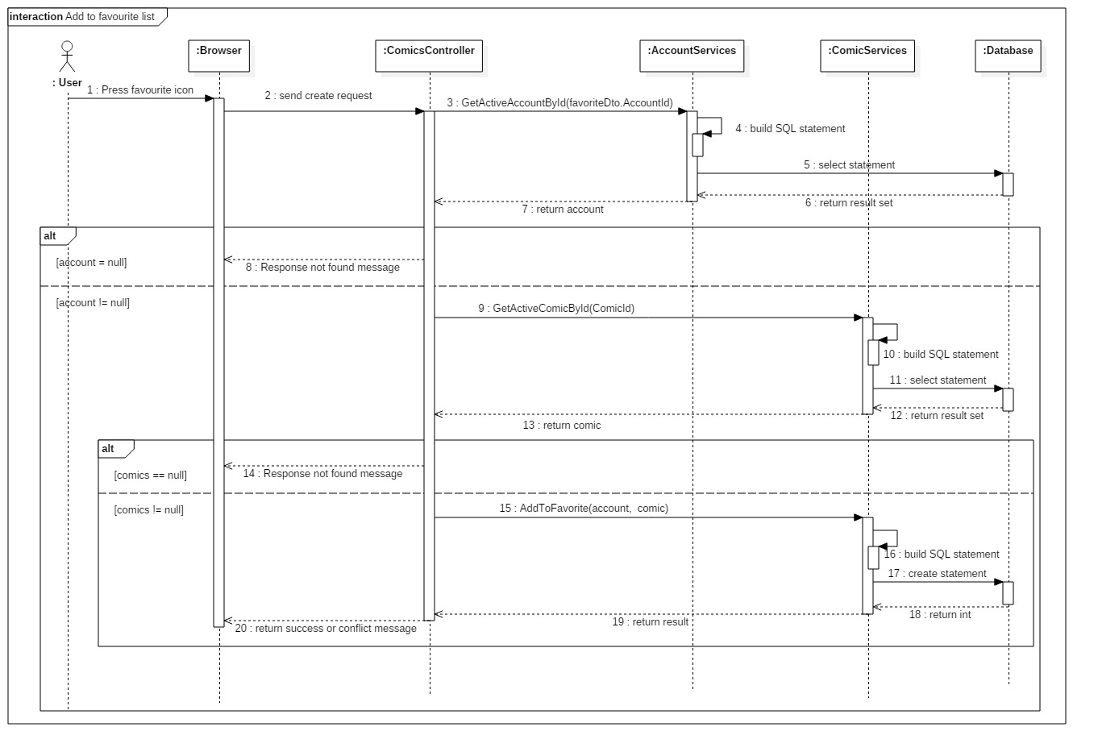
Sequence Diagram
Add to
favourite
list

Slide 17
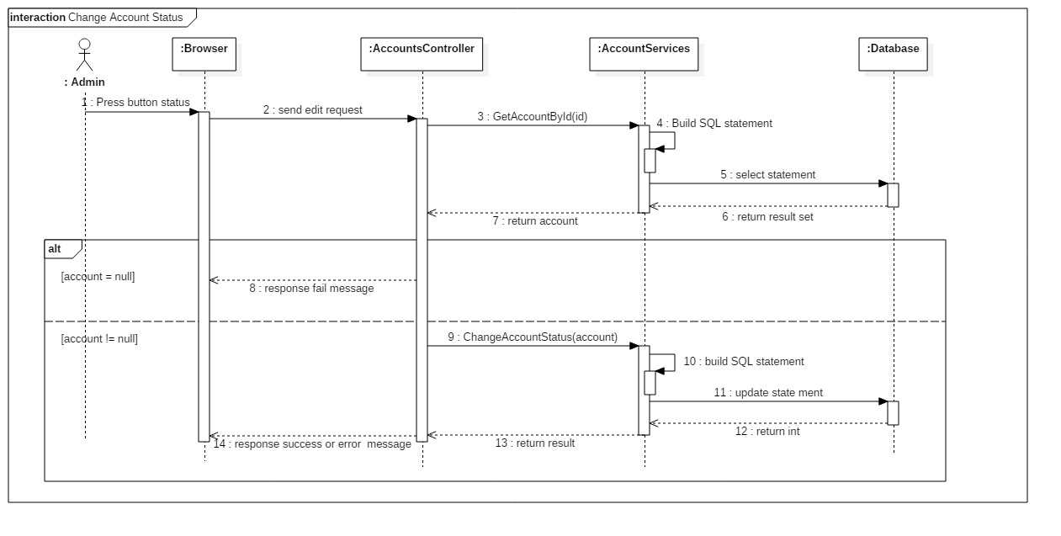
Sequence Diagram
Change Account
status

Slide 18
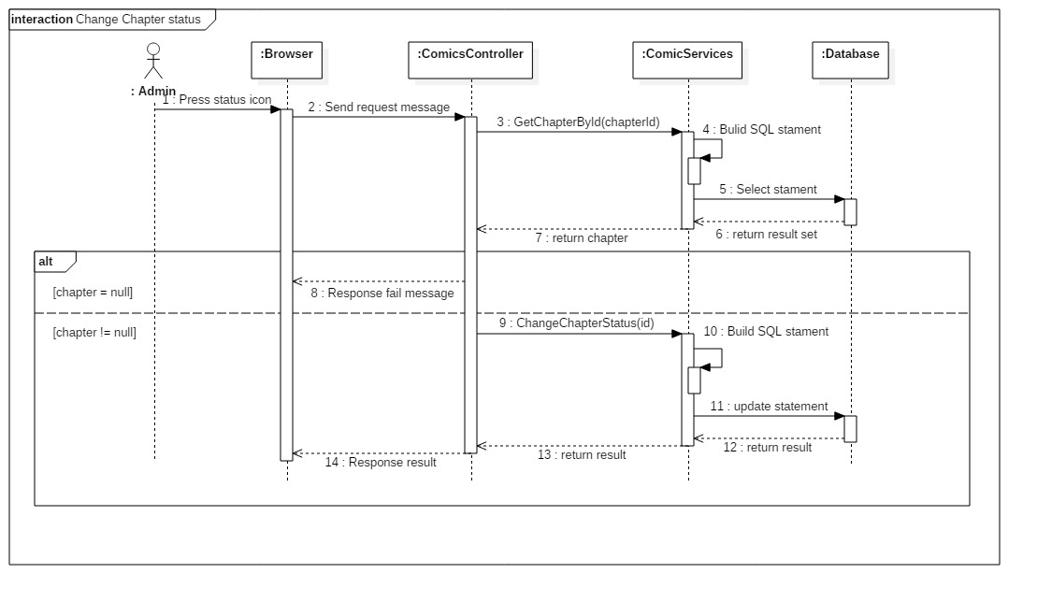
Sequence Diagram
Change Chapter
status

Slide 19
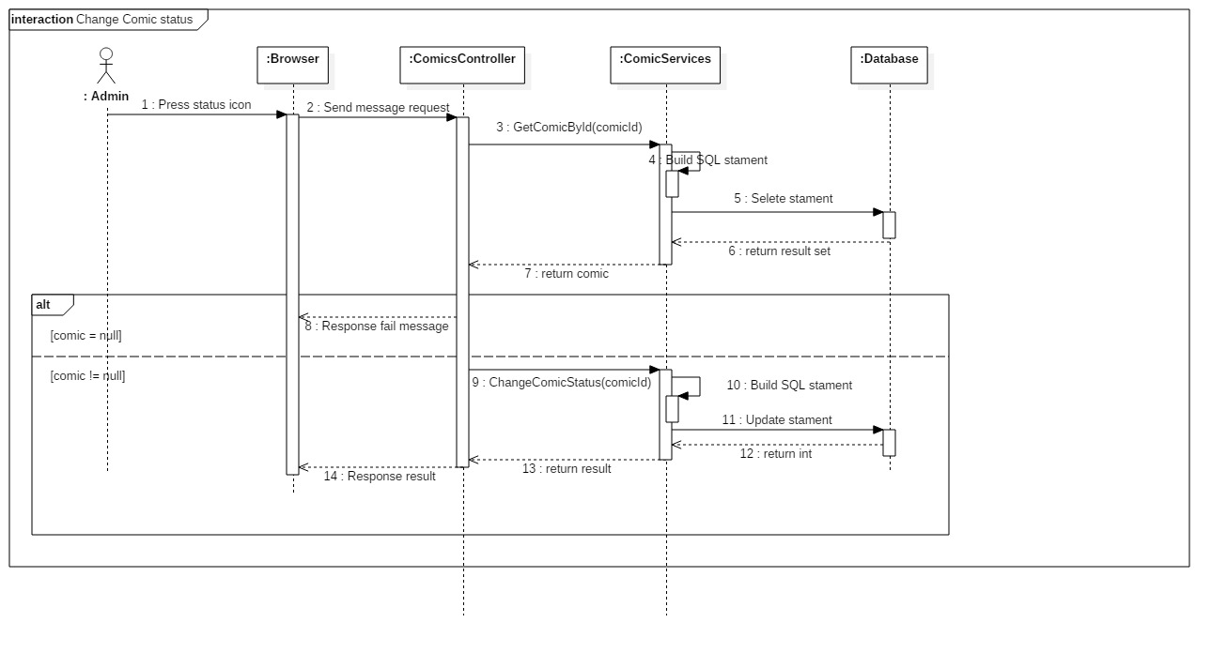
Sequence Diagram
Change
Comic
Status

Slide 20
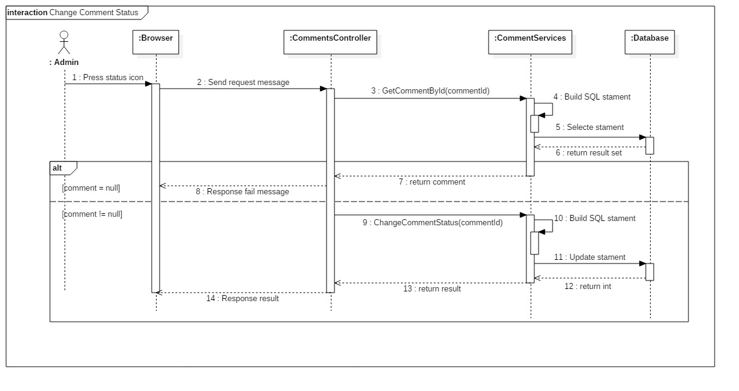
Sequence Diagram
Change Comment
Status

Slide 21
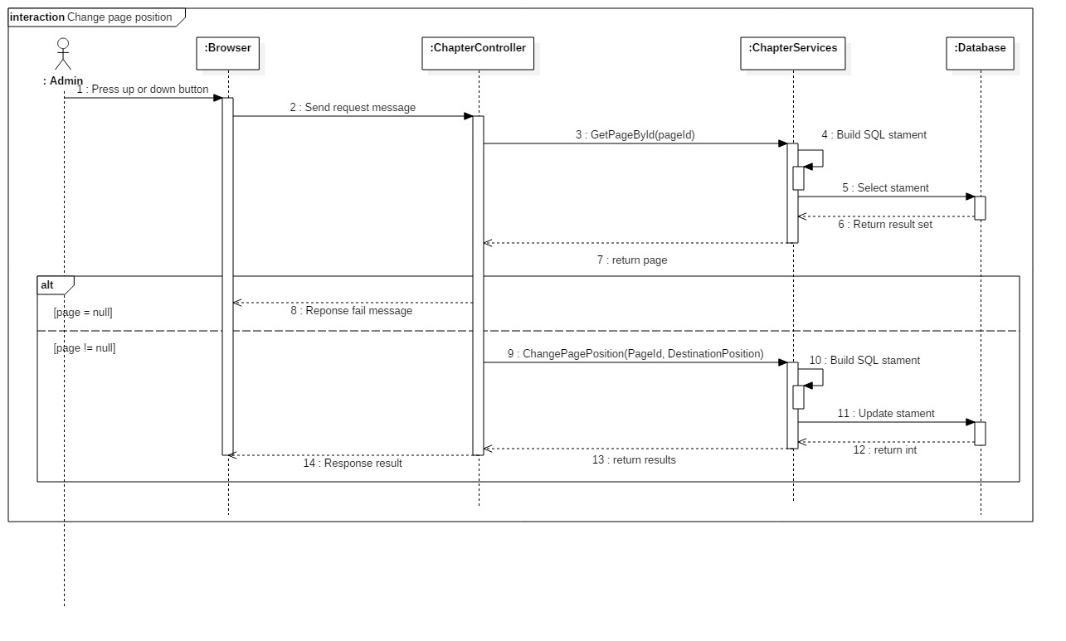
Sequence Diagram
Change page
position

Slide 22
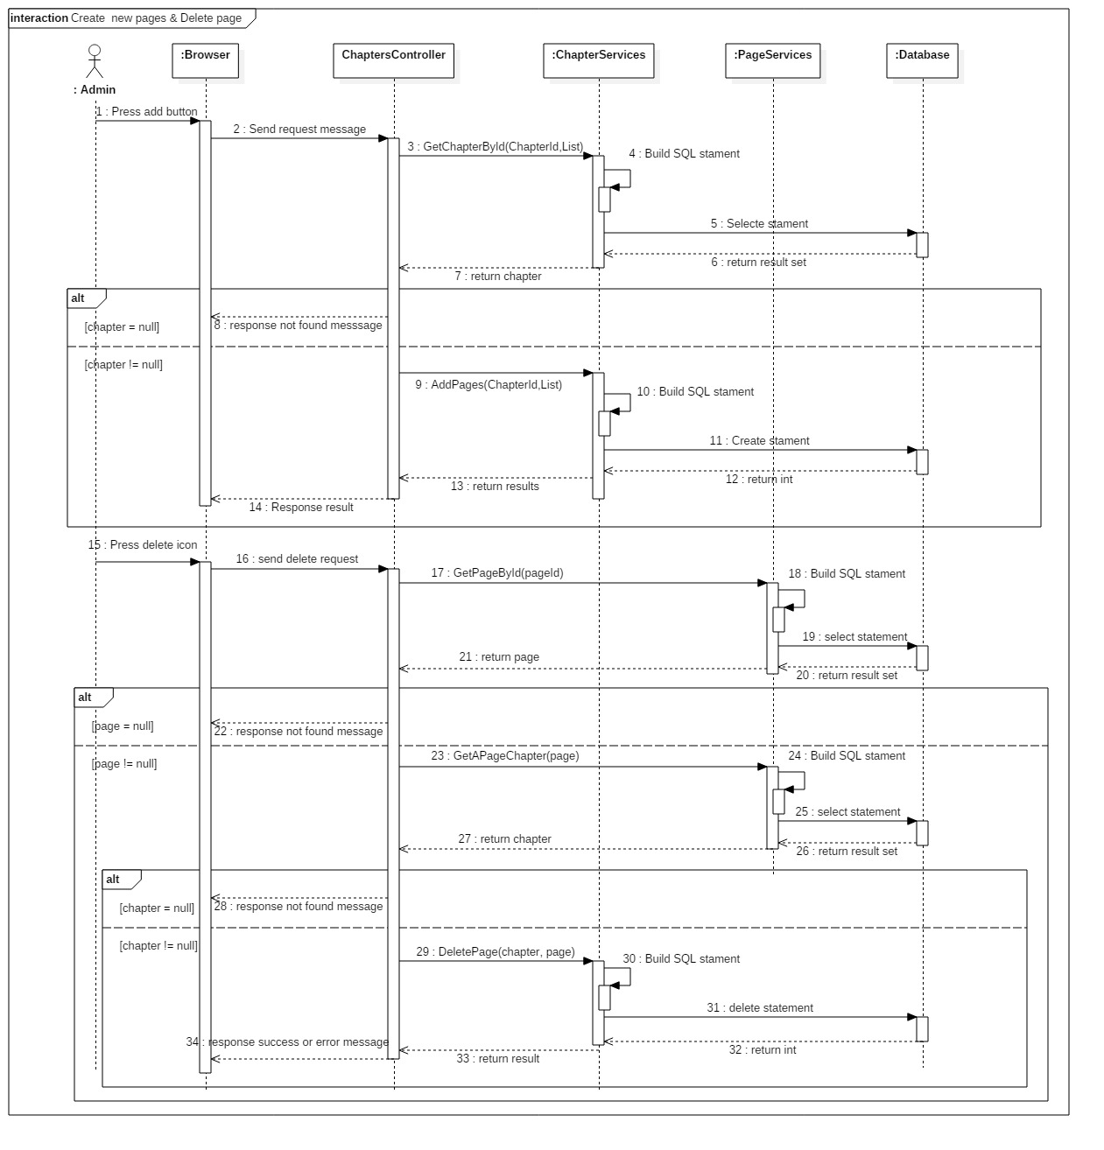
Sequence Diagram
Create and delete new
pages

Slide 23
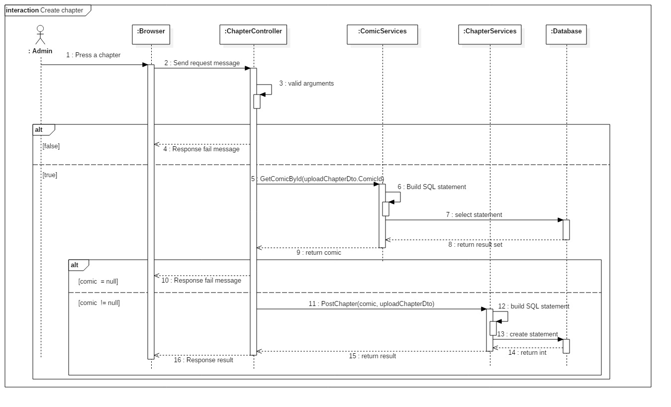
Sequence Diagram
Create chapter

Slide 24
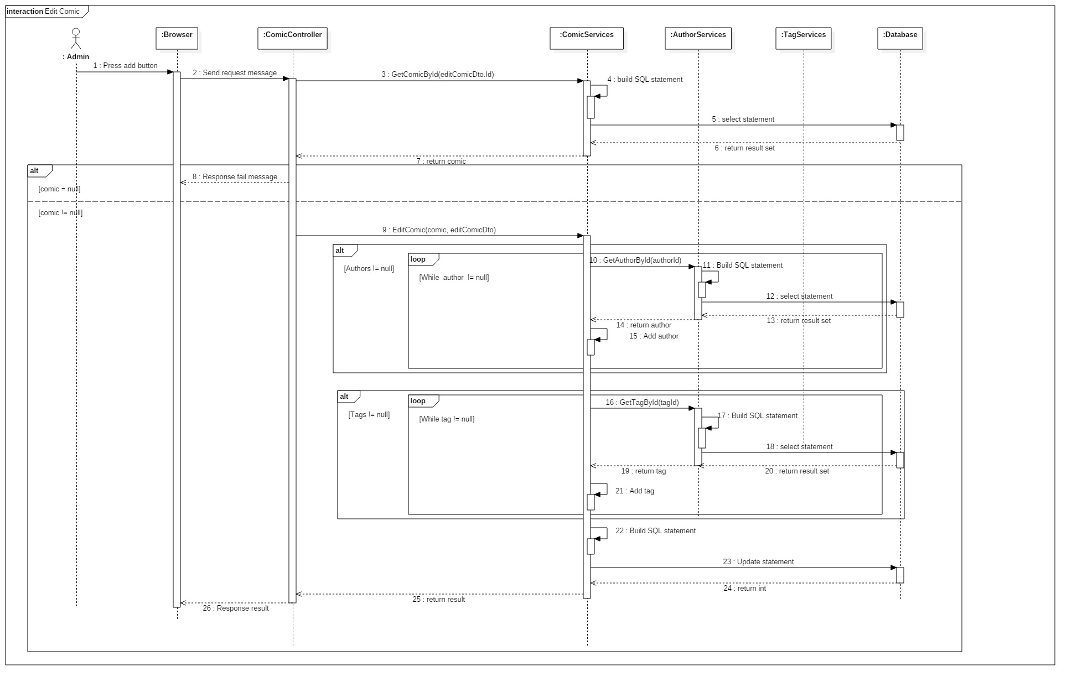
Sequence Diagram
Edit Comic

Slide 25
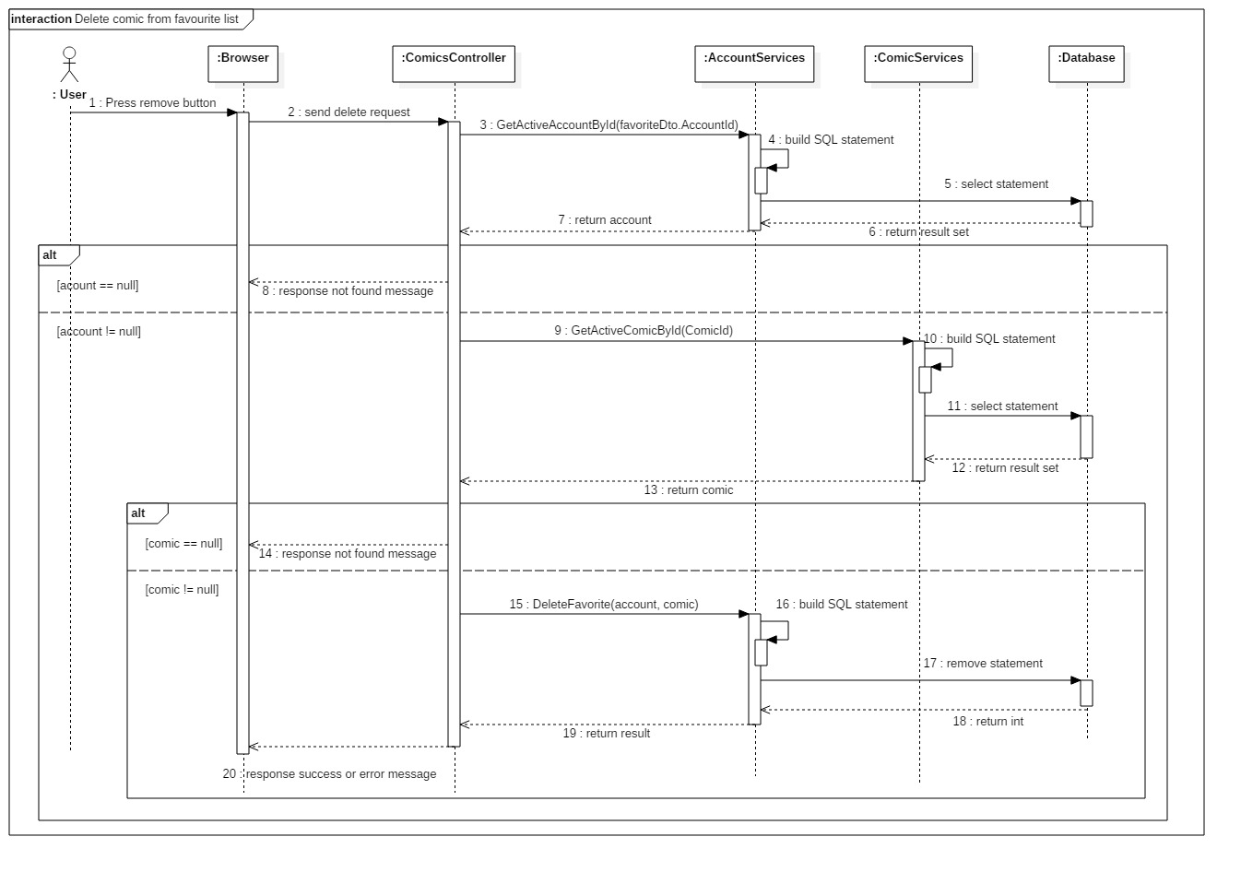
Sequence Diagram
Delete comic from
favourite list

Slide 26
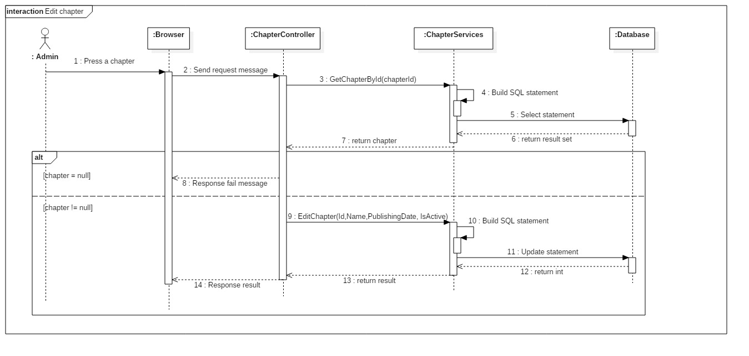
Sequence Diagram
Edit chapter

Slide 27
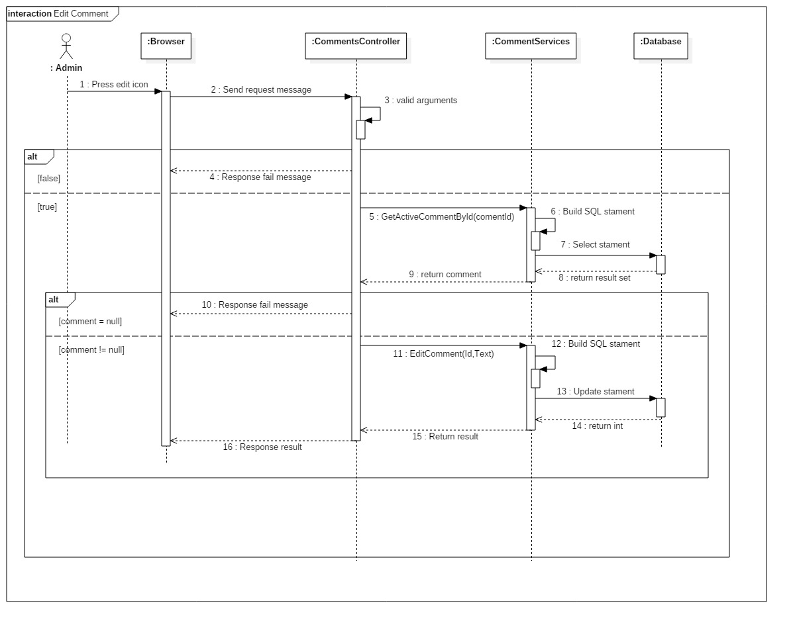
Sequence Diagram
Edit Comment

Slide 28
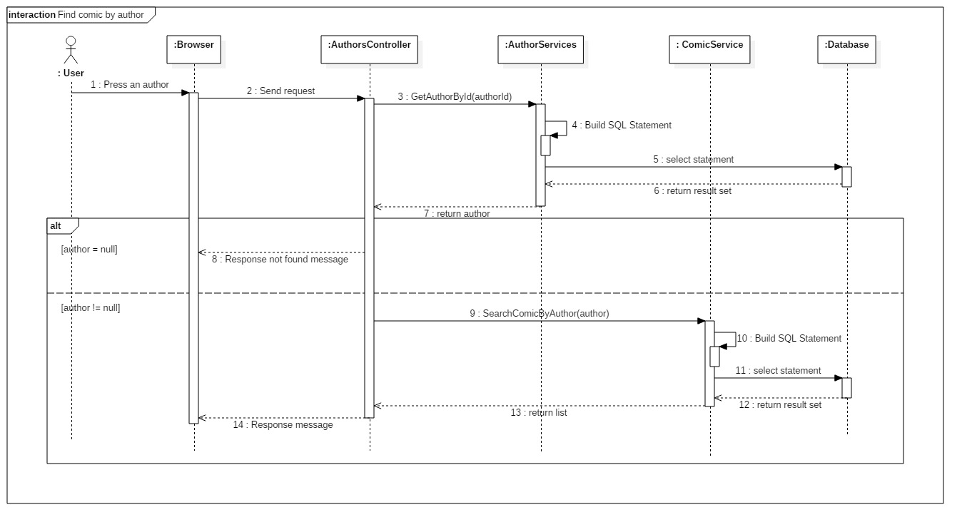
Sequence Diagram
Find comic by author

Slide 29
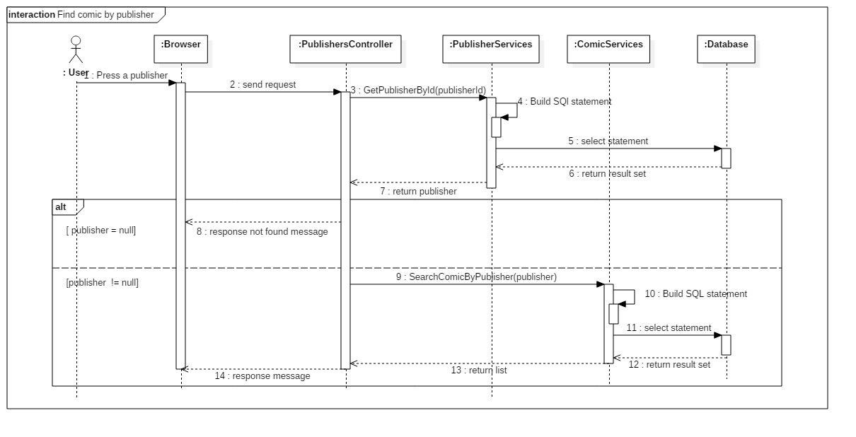
Sequence Diagram
Find comic by
publisher

Slide 30
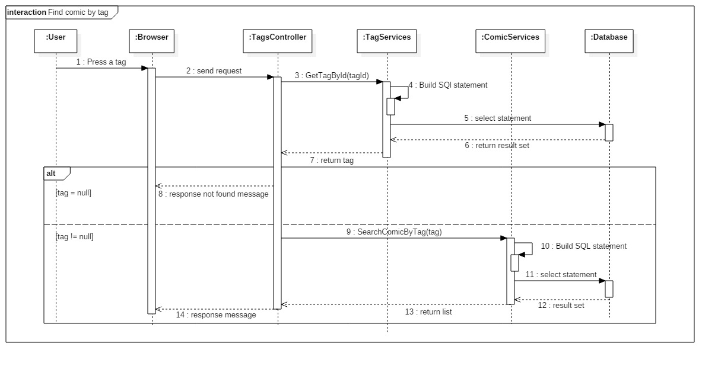
Sequence Diagram
Find comic by tag

Slide 31
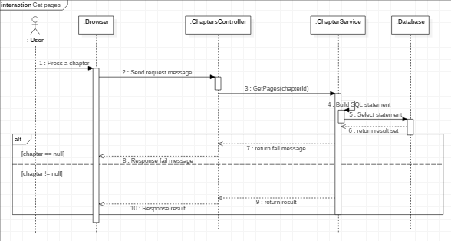
Sequence Diagram
Get pages

Slide 32
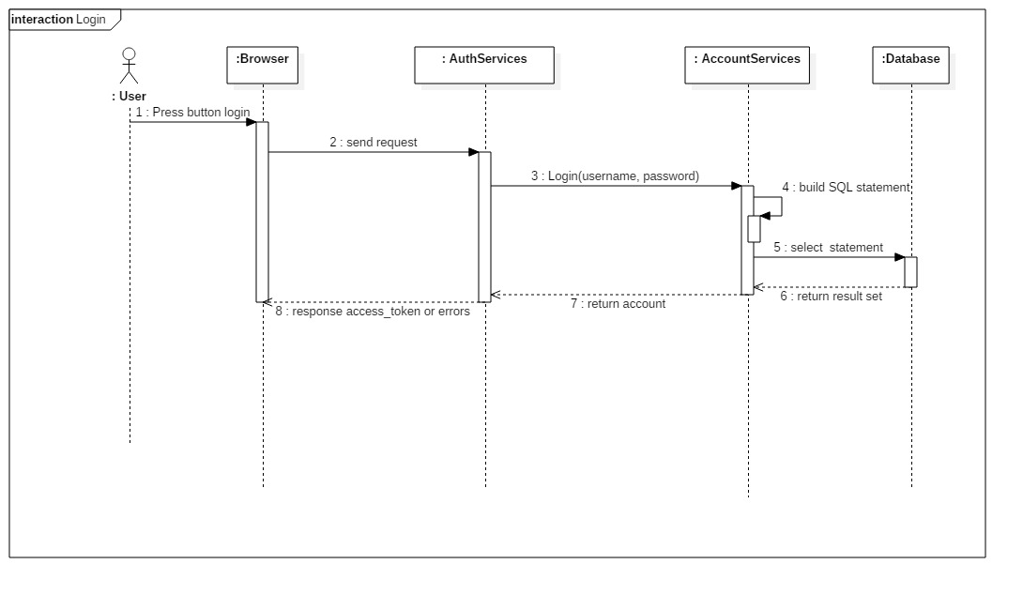
Sequence Diagram
Login

Slide 33
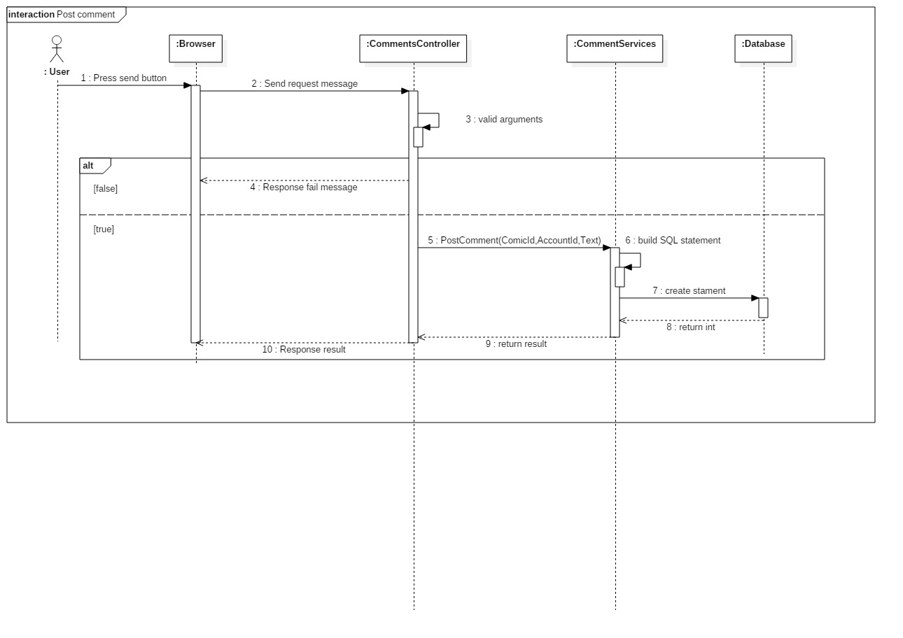
Sequence Diagram
Post comment

Slide 34
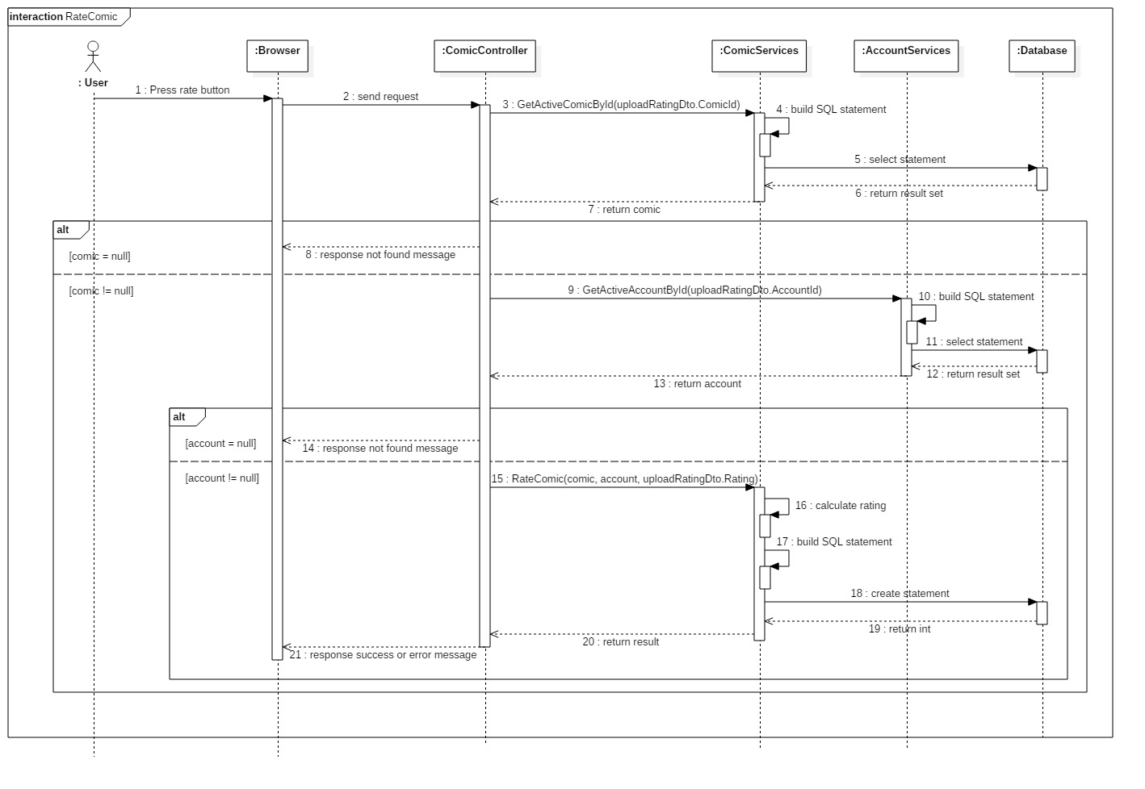
Sequence Diagram
Rate Comic

Slide 35
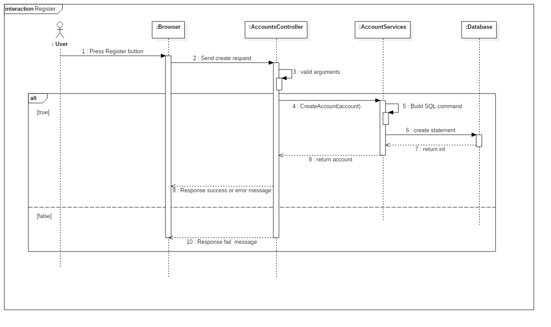
Sequence Diagram
Register

Slide 36
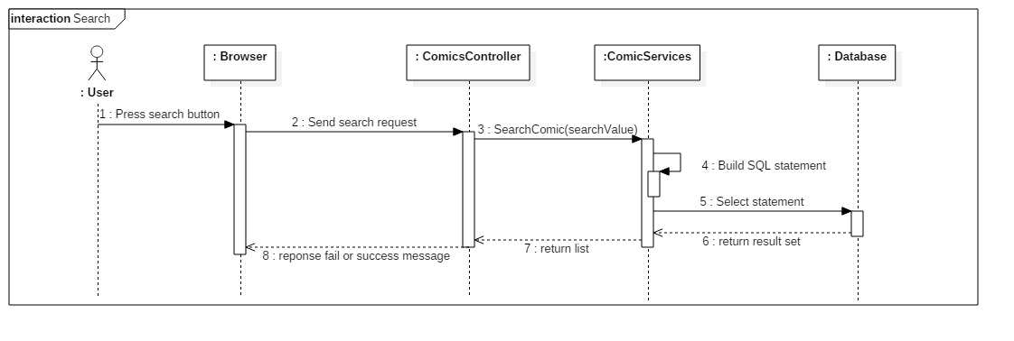
Sequence Diagram
Search

Slide 37
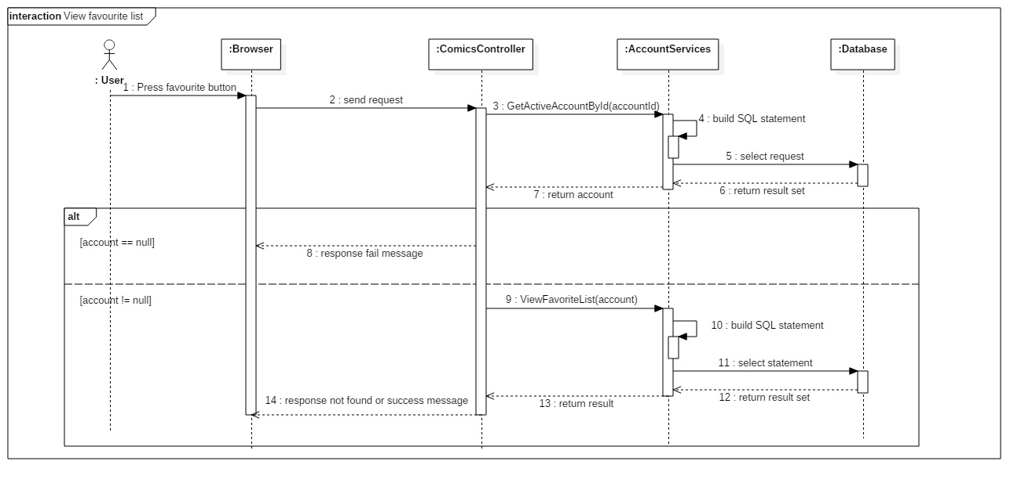
Sequence Diagram
View Favourite List

Slide 38
Demo:

